Slide 1
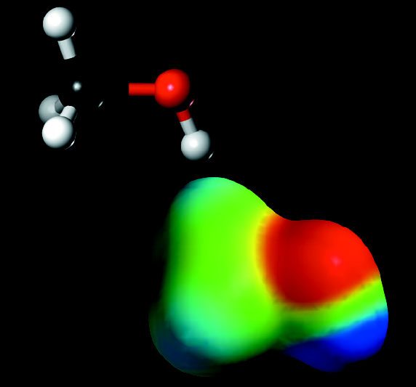
CHAPTER 8
Molecular Structure & Covalent Bonding Theories

Slide 2
Chapter Goals
A Preview of the Chapter
Valence Shell Electron Pair Repulsion (VSEPR) Theory
Polar Molecules:The Influence of Molecular Geometry
Valence Bond (VB) Theory
Molecular Shapes and Bonding

Slide 3
Chapter Goals
Linear Electronic Geometry: AB₂ Species
Trigonal Planar Electronic Geometry: AB₃ Species
Tetrahedral Electronic Geometry: AB₄ Species
Tetrahedral Electronic Geometry: AB₃U Species
Tetrahedral Electronic Geometry: AB₂U₂ Species
Tetrahedral Electronic Geometry – ABU₃ Species
Trigonal Bipyramidal Geometry
Octahedral Geometry
Compounds Containing Double Bonds
Compounds Containing Triple Bonds
A Summary of Electronic and Molecular Geometries

Slide 4
Stereochemistry
Stereochemistry is the study of the three dimensional shapes of molecules.
Some questions to examine in this chapter are:
  Why are we interested in shapes?
  What role does molecular shape play in life?
  How do we determine molecular shapes?
  How do we predict molecular shapes?

Slide 5
Two Simple Theories of Covalent Bonding
Valence Shell Electron Pair Repulsion Theory
  Commonly designated as VSEPR
  Principal originator
    R. J. Gillespie in the 1950’s
Valence Bond Theory
  Involves the use of hybridized atomic orbitals
  Principal originator
    L. Pauling in the 1930’s & 40’s

Slide 6
Overview of Chapter
The same basic approach will be used in every example of molecular structure prediction:
Draw the correct Lewis dot structure.
  Identify the central atom.
  Designate the bonding pairs and lone pairs of electrons on central atom.
Count the regions of high electron density on the central atom.
  Include both bonding and lone pairs in the counting.

Slide 7
Overview of Chapter
Determine the electronic geometry around the central atom.
  VSEPR is a guide to the geometry.
Determine the molecular geometry around the central atom.
  Ignore the lone pairs of electrons.
Adjust molecular geometry for effect of any lone pairs.

Slide 8
Overview of Chapter
Determine the hybrid orbitals on central atom.
Repeat procedure if there is more than one central atom in molecule.
Determine molecular polarity from entire molecular geometry using electronegativity differences.

Slide 9
VSEPR Theory
Regions of high electron density around the central atom are arranged as far apart as possible to minimize repulsions.
There are five basic molecular shapes based on the number of regions of high electron density around the central atom.
Several modifications of these five basic shapes will also be examined.

Slide 10
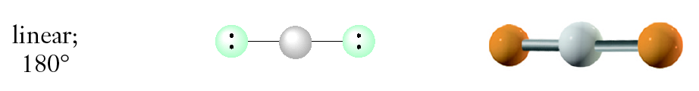
VSEPR Theory
Two regions of high electron density around the central atom.

Slide 11
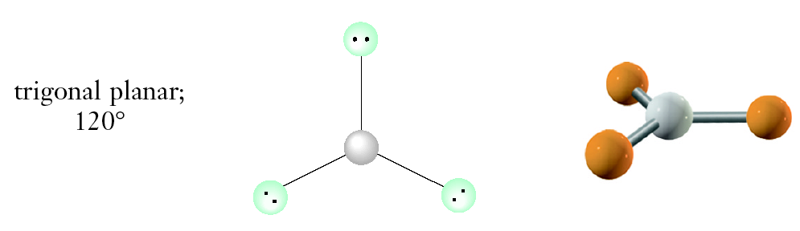
VSEPR Theory
Three regions of high electron density around the central atom.

Slide 12
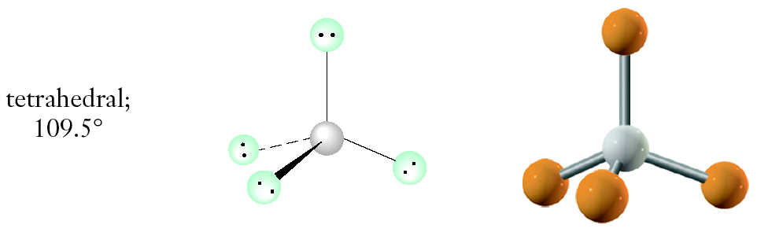
VSEPR Theory
Four regions of high electron density around the central atom.

Slide 13
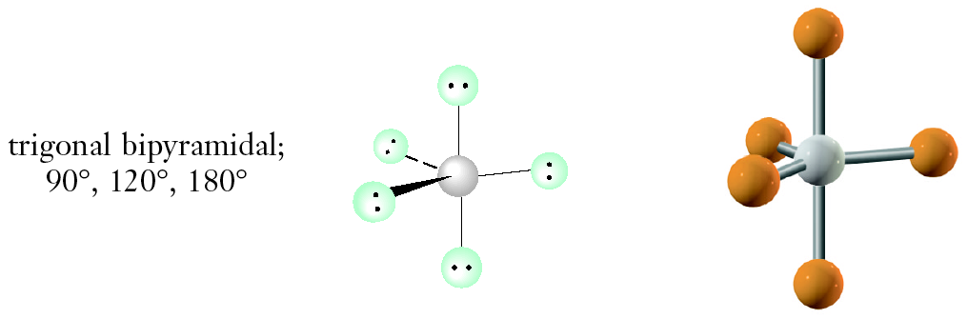
VSEPR Theory
Five regions of high electron density around the central atom.

Slide 14
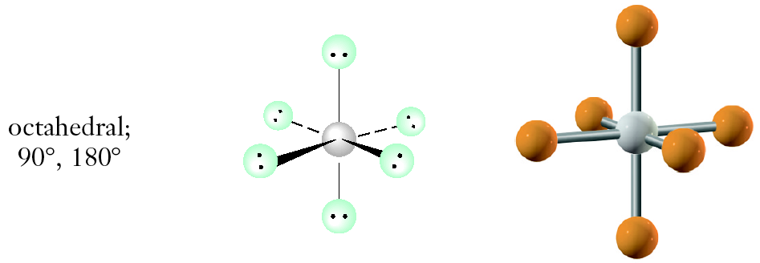
VSEPR Theory
Six regions of high electron density around the central atom.

Slide 15
VSEPR Theory
Frequently, we will describe two geometries for each molecule.
Electronic geometry is determined by the locations of regions of high electron density around the central atom(s).
Molecular geometry determined by the arrangement of atoms around the central atom(s).
  Electron pairs are not used in the molecular geometry determination just the positions of the atoms in the molecule are used.

Slide 16
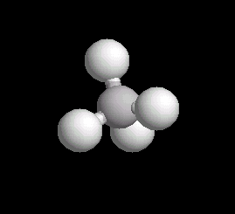
VSEPR Theory
An example of a molecule that has the same electronic and molecular geometries is methane - CH₄.
Electronic and molecular geometries are tetrahedral.

Slide 17
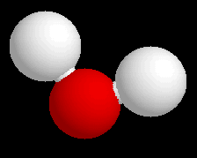
VSEPR Theory
An example of a molecule that has different electronic and molecular geometries is water - H₂O.
Electronic geometry is tetrahedral.
Molecular geometry is bent or angular.

Slide 18
VSEPR Theory
Lone pairs of electrons (unshared pairs) require more volume than shared pairs.
  Consequently, there is an ordering of repulsions of electrons around central atom.
Criteria for the ordering of the repulsions:

Slide 19
VSEPR Theory
Lone pair to lone pair is the strongest repulsion.
Lone pair to bonding pair is intermediate repulsion.
Bonding pair to bonding pair is weakest repulsion.
Mnemonic for repulsion strengths
  lp/lp > lp/bp > bp/bp
Lone pair to lone pair repulsion is why bond angles in water are less than 109.5º.

Slide 20
Polar Molecules: The Influence of Molecular Geometry
Molecular geometry affects molecular polarity.
  Due to the effect of the bond dipoles and how they either cancel or reinforce each other.
A B A
A B
A
linear molecule
nonpolar
angular molecule
polar

Slide 21
Polar Molecules: The Influence of Molecular Geometry
Polar Molecules must meet two requirements:
  One polar bond or one lone pair of electrons on central atom.
  Neither bonds nor lone pairs can be symmetrically arranged that their polarities cancel.

Slide 22
Valence Bond (VB) Theory
Covalent bonds are formed by the overlap of atomic orbitals.
Atomic orbitals on the central atom can mix and exchange their character with other atoms in a molecule.
  Process is called hybridization.
Hybrids are common:
  Pink flowers
  Mules
Hybrid Orbitals have the same shapes as predicted by VSEPR.

Slide 23
Valence Bond (VB) Theory
Regions of High Electron Density | Electronic Geometry | Hybridization
2 | Linear | sp
3 | Trigonal planar | sp²
4 | Tetrahedral | sp³
5 | Trigonal bipyramidal | sp³d
6 | Octahedral | sp³d²

Slide 24
Molecular Shapes and Bonding
In the next sections we will use the following terminology:
  A = central atom
  B = bonding pairs around central atom
  U = lone pairs around central atom
For example:
  AB₃U designates that there are 3 bonding pairs and 1 lone pair around the central atom.

Slide 25
Linear Electronic Geometry:AB₂ Species (No Lone Pairs of Electrons on A)
Some examples of molecules with this geometry are:
  BeCl₂, BeBr₂, BeI₂, HgCl₂, CdCl₂
All of these examples are linear, nonpolar molecules.
Important exceptions occur when the two substituents are not the same!
  BeClBr or BeIBr will be linear and polar!

Slide 26


Linear Electronic Geometry:AB₂ Species (No Lone Pairs of Electrons on A)
Electronic Structures

Lewis Formulas
1s 2s 2p
Be ↑↓ ↑↓
3s 3p
Cl [Ne] ↑↓ ↑↓ ↑↓ ↑

Slide 27
Linear Electronic Geometry:AB₂ Species (No Lone Pairs of Electrons on A)
Dot Formula
Electronic Geometry

Slide 28
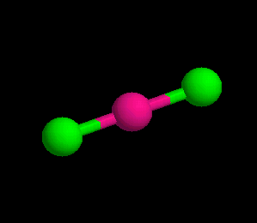
Linear Electronic Geometry:AB₂ Species (No Lone Pairs of Electrons on A)
Molecular Geometry
Polarity

Slide 29
Linear Electronic Geometry:AB₂ Species (No Lone Pairs of Electrons on A)
Valence Bond Theory (Hybridization)
1s 2s 2p
Be ↑↓ ↑↓
1s sp hybrid 2p
⇒ ↑↓ ↑ ↑
3s 3p
Cl [Ne] ↑↓↑↓ ↑↓ ↑

Slide 30
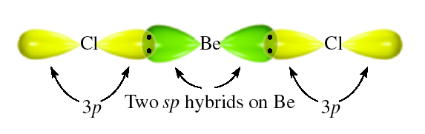
Linear Electronic Geometry:AB₂ Species (No Lone Pairs of Electrons on A)

Slide 31
Trigonal Planar Electronic Geometry: AB₃ Species (No Lone Pairs of Electrons on A)
Some examples of molecules with this geometry are:
  BF₃, BCl₃
All of these examples are trigonal planar, nonpolar molecules.
Important exceptions occur when the three substituents are not the same!
  BF₂Cl or BCI₂Br will be trigonal planar and polar!

Slide 32

Trigonal Planar Electronic Geometry: AB₃ Species (No Lone Pairs of Electrons on A)
Electronic Structures
Lewis Formulas
1s 2s 2p
B ↑↓ ↑↓ ↑
3s 3p
Cl [Ne] ↑↓ ↑↓ ↑↓ ↑

Slide 33
Trigonal Planar Electronic Geometry: AB₃ Species (No Lone Pairs of Electrons on A)
Dot Formula
Electronic Geometry

Slide 34
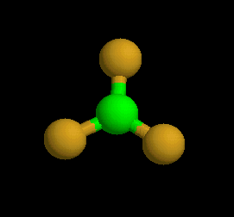
Trigonal Planar Electronic Geometry: AB₃ Species (No Lone Pairs of Electrons on A)
Molecular Geometry
Polarity

Slide 35
Trigonal Planar Electronic Geometry: AB₃ Species (No Lone Pairs of Electrons on A)
Valence Bond Theory (Hybridization)
1s 2s 2p
B ↑↓ ↑↓ ↑
1s sp² hybrid
⇒ ↑↓ ↑ ↑ ↑
3s 3p
Cl [Ne] ↑↓ ↑↓ ↑↓ ↑

Slide 36
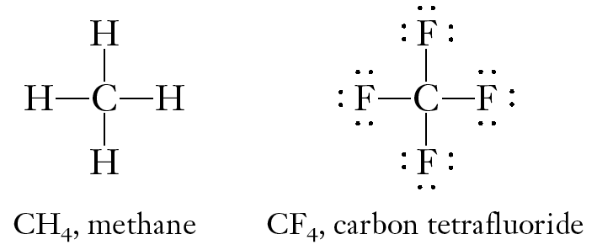
Trigonal Planar Electronic Geometry: AB₃ Species (No Lone Pairs of Electrons on A)

Slide 37
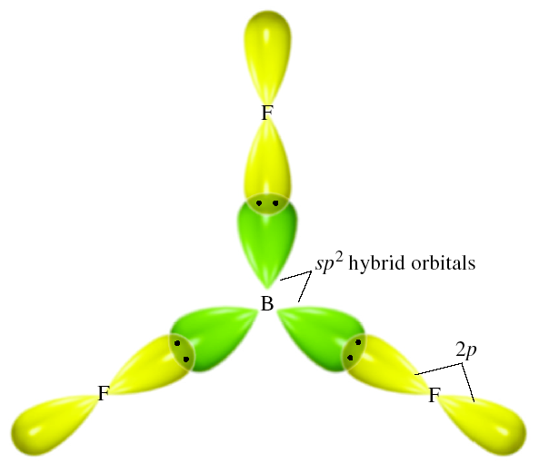
Trigonal Planar Electronic Geometry: AB₃ Species (No Lone Pairs of Electrons on A)

Slide 38
Tetrahedral Electronic Geometry: AB₄ Species (No Lone Pairs of Electrons on A)
Some examples of molecules with this geometry are:
  CH₄, CF₄, CCl₄, SiH₄, SiF₄
All of these examples are tetrahedral, nonpolar molecules.
Important exceptions occur when the four substituents are not the same!
  CF₃Cl or CH₂CI₂ will be tetrahedral and polar!

Slide 39
Tetrahedral Electronic Geometry: AB₄ Species (No Lone Pairs of Electrons on A)
Electronic Structures
Lewis Formulas
2s 2p
C [He] ↑↓ ↑ ↑
1s
H ↑

Slide 40
Tetrahedral Electronic Geometry: AB₄ Species (No Lone Pairs of Electrons on A)
Dot Formula
Electronic Geometry

Slide 41
Tetrahedral Electronic Geometry: AB₄ Species (No Lone Pairs of Electrons on A)
Molecular Geometry
Polarity

Slide 42
Tetrahedral Electronic Geometry: AB₄ Species (No Lone Pairs of Electrons on A)
Valence Bond Theory (Hybridization)
2s 2p
C [He] ↑↓ ↑ ↑
four sp³ hybrid orbitals
⇒ C [He] ↑ ↑ ↑ ↑
1s
H ↑

Slide 43
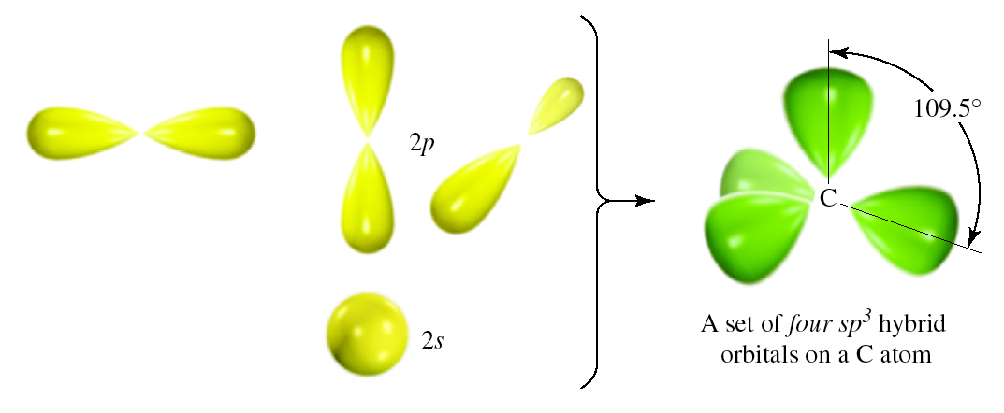
Tetrahedral Electronic Geometry: AB₄ Species (No Lone Pairs of Electrons on A)

Slide 44
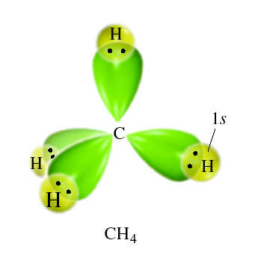
Tetrahedral Electronic Geometry: AB₄ Species (No Lone Pairs of Electrons on A)

Slide 45
Example of Molecules with More Than One Central Atom
Alkanes C_{n}H_{2n+2}
Alkanes are hydrocarbons with the general formula C_{n}H_{2n+2}.
  CH₄ - methane
  C₂H₆ or (H₃C-CH₃) - ethane
  C₃H₈ or (H₃C-CH₂-CH₃) - propane
The C atoms are located at the center of a tetrahedron.
  Each alkane is a chain of interlocking tetrahedra.
  Sufficient H atoms to form a total of four bonds for each C.

Slide 46
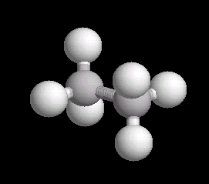
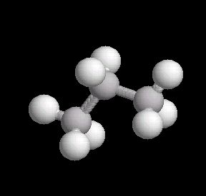
Example of Molecules with More Than One Central Atom
Alkanes C_{n}H_{2n+2}

Slide 47
Tetrahedral Electronic Geometry: AB₃U Species (One Lone Pair of Electrons on A)
Some examples of molecules with this geometry are:
  NH₃, NF₃, PH₃, PCl₃, AsH₃
These molecules are our first examples of central atoms with lone pairs of electrons.
  Thus, the electronic and molecular geometries are different.
  All three substituents are the same but molecule is polar.
NH₃ and NF₃ are trigonal pyramidal, polar molecules.

Slide 48
Tetrahedral Electronic Geometry: AB₃U Species (One Lone Pair of Electrons on A)
Lewis Formulas
Electronic Structures
2s 2p
N [He] ↑↓ ↑ ↑ ↑
2s 2p
F [He] ↑↓ ↑↓ ↑↓ ↑
1s
H ↑

Slide 49
Tetrahedral Electronic Geometry: AB₃U Species (One Lone Pair of Electrons on A)
Dot Formulas
Electronic Geometry

Slide 50
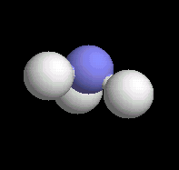
Tetrahedral Electronic Geometry: AB₃U Species (One Lone Pair of Electrons on A)
Molecular Geometry
Polarity

Slide 51
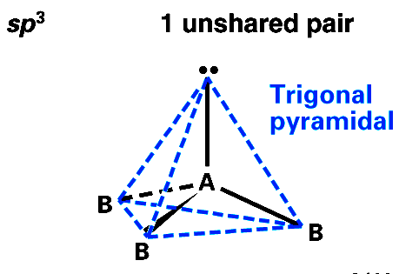
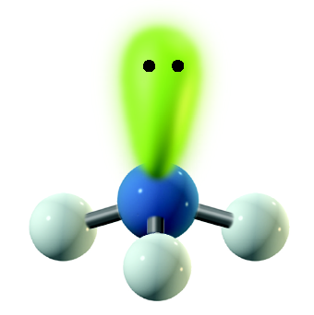
Tetrahedral Electronic Geometry: AB₃U Species (One Lone Pair of Electrons on A)
Valence Bond Theory (Hybridization)
2s 2p
N [He] ↑↓ ↑ ↑ ↑
four sp³ hybrids
⇒  ↑↓ ↑ ↑ ↑

Slide 52
Tetrahedral Electronic Geometry: AB₂U₂ Species (Two Lone Pairs of Electrons on A)
Some examples of molecules with this geometry are:
  H₂O, OF₂, H₂S
These molecules are our first examples of central atoms with two lone pairs of electrons.
  Thus, the electronic and molecular geometries are different.
  Both substituents are the same but molecule is polar.
Molecules are angular, bent, or V-shaped and polar.

Slide 53
Tetrahedral Electronic Geometry: AB₂U₂ Species (Two Lone Pairs of Electrons on A)
Lewis Formulas
Electronic Structures

2s 2p
O [He] ↑↓ ↑↓ ↑ ↑
1s
H  ↑

Slide 54
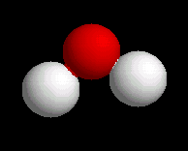
Tetrahedral Electronic Geometry: AB₂U₂ Species (Two Lone Pairs of Electrons on A)
Molecular Geometry
Polarity

Slide 55
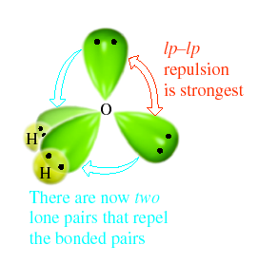
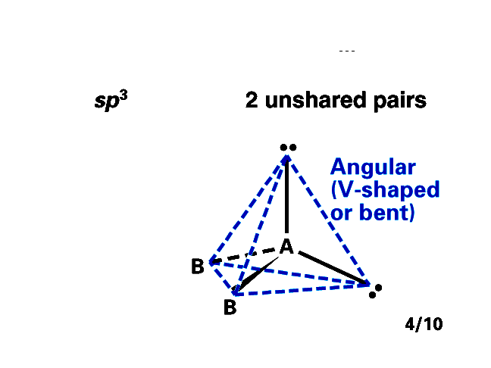
Tetrahedral Electronic Geometry: AB₂U₂ Species (Two Lone Pairs of Electrons on A)
Valence Bond Theory (Hybridization)
2s 2p
O [He] ↑↓ ↑↓ ↑ ↑
four sp³ hybrids
⇒ ↑↓ ↑↓ ↑ ↑

Slide 56
Tetrahedral Electronic Geometry: ABU₃ Species (Three Lone Pairs of Electrons on A)
Some examples of molecules with this geometry are:
  HF, HCl, HBr, HI, FCl, IBr
These molecules are examples of central atoms with three lone pairs of electrons.
  Again, the electronic and molecular geometries are different.
Molecules are linear and polar when the two atoms are different.
  Cl₂, Br₂, I₂ are nonpolar.

Slide 57
Tetrahedral Electronic Geometry: ABU₃ Species (Three Lone Pairs of Electrons on A)
Dot Formula
Electronic Geometry

Slide 58
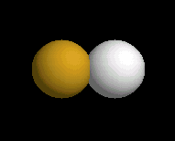
Tetrahedral Electronic Geometry: ABU₃ Species (Three Lone Pairs of Electrons on A)
Molecular Geometry
Polarity
HF is a polar molecule.

Slide 59
Tetrahedral Electronic Geometry: ABU₃ Species (Three Lone Pairs of Electrons on A)
Valence Bond Theory (Hybridization)
2s 2p
F [He] ↑↓ ↑↓ ↑↓ ↑
four sp³ hybrids
⇒ ↑↓ ↑↓ ↑↓ ↑

Slide 60
Trigonal Bipyramidal Electronic Geometry: AB₅, AB₄U, AB₃U2, and AB₂U₃
Some examples of molecules with this geometry are:
  PF₅, AsF₅, PCl₅, etc.
These molecules are examples of central atoms with five bonding pairs of electrons.
  The electronic and molecular geometries are the same.
Molecules are trigonal bipyramidal and nonpolar when all five substituents are the same.
  If the five substituents are not the same polar molecules can result, AsF₄Cl is an example.

Slide 61
Trigonal Bipyramidal Electronic Geometry: AB₅, AB₄U, AB₃U2, and AB₂U₃
Electronic Structures
Lewis Formulas
4s 4p
As [Ar] 3d¹⁰ ↑↓ ↑ ↑ ↑
2s 2p
F [He] ↑↓ ↑↓ ↑↓ ↑

Slide 62
Trigonal Bipyramidal Electronic Geometry: AB₅, AB₄U, AB₃U2, and AB₂U₃
Dot Formula
Electronic Geometry

Slide 63
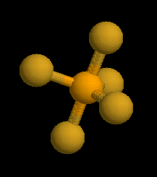
Trigonal Bipyramidal Electronic Geometry: AB₅, AB₄U, AB₃U2, and AB₂U₃
Molecular Geometry
Polarity

Slide 64
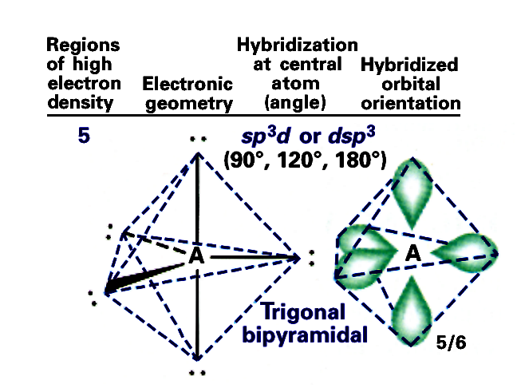
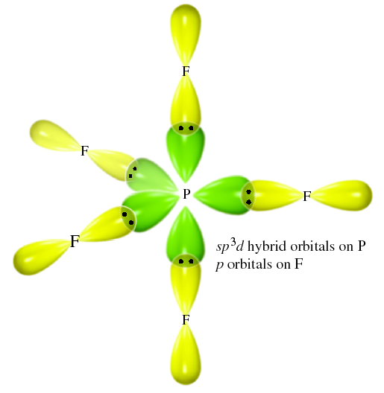
Trigonal Bipyramidal Electronic Geometry: AB₅, AB₄U, AB₃U2, and AB₂U₃
Valence Bond Theory (Hybridization)
4s 4p 4d
As [Ar] 3d¹⁰ ↑↓ ↑ ↑ ↑ ___ ___ ___ ___ ___
⇓
five sp³ d hybrids 4d
↑ ↑ ↑ ↑ ↑  ___ ___ ___ ___ ___

Slide 65
Trigonal Bipyramidal Electronic Geometry: AB₅, AB₄U, AB₃U2, and AB₂U₃
If lone pairs are incorporated into the trigonal bipyramidal structure, there are three possible new shapes.
  One lone pair - Seesaw shape
  Two lone pairs - T-shape
  Three lone pairs – linear
The lone pairs occupy equatorial positions because they are 120º from two bonding pairs and 90º from the other two bonding pairs.
  Results in decreased repulsions compared to lone pair in axial position.

Slide 66
Trigonal Bipyramidal Electronic Geometry: AB₅, AB₄U, AB₃U2, and AB₂U₃
AB₄U molecules have:
    trigonal bipyramid electronic geometry
    seesaw shaped molecular geometry
    and are polar
One example of an AB₄U molecule is
  SF₄
Hybridization of S atom is sp³d.

Slide 67
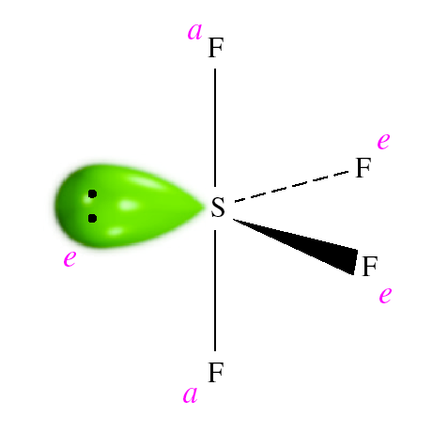
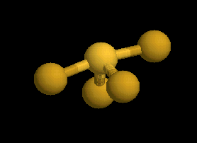
Trigonal Bipyramidal Electronic Geometry: AB₅, AB₄U, AB₃U2, and AB₂U₃
Molecular Geometry

Slide 68
Trigonal Bipyramidal Electronic Geometry: AB₅, AB₄U, AB₃U₂, and AB₂U₃
AB₃U₂ molecules have:
    trigonal bipyramid electronic geometry
    T-shaped molecular geometry
    and are polar
One example of an AB₃U₂ molecule is
  IF₃
Hybridization of I atom is sp³d.

Slide 69
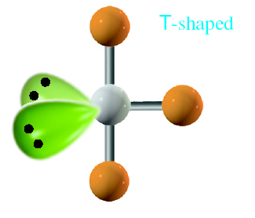
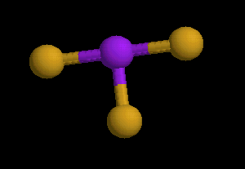
Trigonal Bipyramidal Electronic Geometry: AB₅, AB₄U, AB₃U2, and AB₂U₃
Molecular Geometry

Slide 70
Trigonal Bipyramidal Electronic Geometry: AB₅, AB₄U, AB₃U2, and AB₂U₃
AB₂U₃ molecules have:
    trigonal bipyramid electronic geometry
    linear molecular geometry
    and are nonpolar
One example of an AB₃U₂ molecule is
  XeF₂
Hybridization of Xe atom is sp³d.

Slide 71
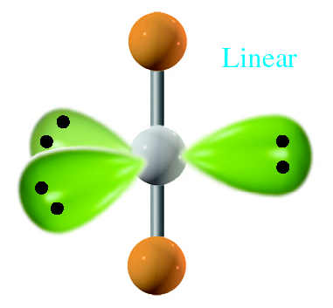
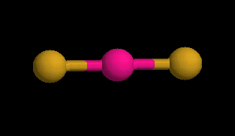
Trigonal Bipyramidal Electronic Geometry: AB₅, AB₄U, AB₃U2, and AB₂U₃
Molecular Geometry

Slide 72
Octahedral Electronic Geometry: AB₆, AB₅U, and AB₄U₂
Some examples of molecules with this geometry are:
  SF₆, SeF₆, SCl₆, etc.
These molecules are examples of central atoms with six bonding pairs of electrons.
Molecules are octahedral and nonpolar when all six substituents are the same.
  If the six substituents are not the same polar molecules can result, SF₅Cl is an example.

Slide 73
Octahedral Electronic Geometry: AB₆, AB₅U, and AB₄U₂
Electronic Structures
Lewis Formulas
4s 4p
Se [Ar] 3d¹⁰ ↑↓↑↓ ↑ ↑
2s 2p
F [He] ↑↓ ↑↓ ↑↓ ↑

Slide 74
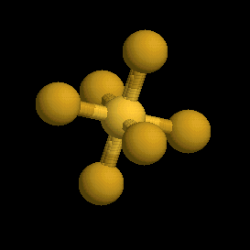
Octahedral Electronic Geometry: AB₆, AB₅U, and AB₄U₂
Polarity
Molecular Geometry

Slide 75
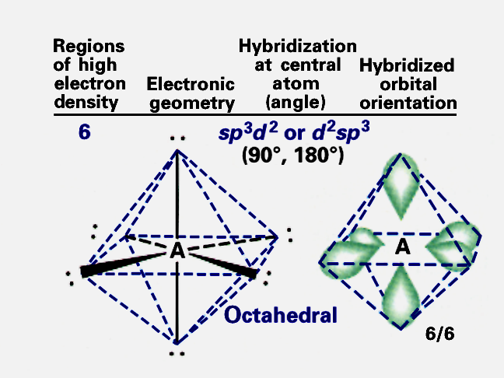
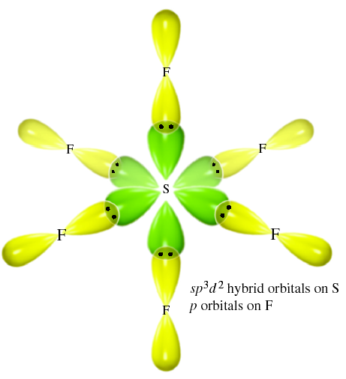
Octahedral Electronic Geometry: AB₆, AB₅U, and AB₄U₂
Valence Bond Theory (Hybridization)
4s 4p 4d
Se [Ar] 3d¹⁰ ↑↓ ↑↓ ↑ ↑ __ __ __ __ __
⇓
six sp³ d² hybrids 4d
↑ ↑ ↑ ↑ ↑ ↑  __ __ __ __

Slide 76
Octahedral Electronic Geometry: AB₆, AB₅U, and AB₄U₂
If lone pairs are incorporated into the octahedral structure, there are two possible new shapes.
  One lone pair - square pyramidal
  Two lone pairs - square planar
The lone pairs occupy axial positions because they are 90º from four bonding pairs.
  Results in decreased repulsions compared to lone pairs in equatorial positions.

Slide 77
Octahedral Electronic Geometry: AB₆, AB₅U, and AB₄U₂
AB₅U molecules have:
    octahedral electronic geometry
    Square pyramidal molecular geometry
    and are polar.
One example of an AB₄U molecule is
  IF₅
Hybridization of I atom is sp³d².

Slide 78
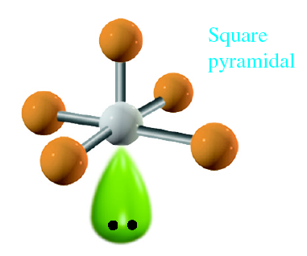
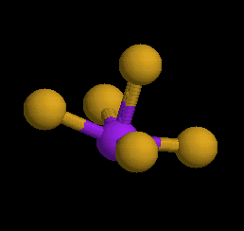
Octahedral Electronic Geometry: AB₆, AB₅U, and AB₄U₂
Molecular Geometry

Slide 79
Octahedral Electronic Geometry: AB₆, AB₅U, and AB₄U₂
AB₄U₂ molecules have:
    octahedral electronic geometry
    square planar molecular geometry
    and are nonpolar.
One example of an AB₄U₂ molecule is
  XeF₄
Hybridization of Xe atom is sp³d².

Slide 80
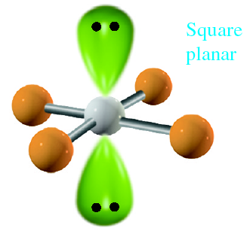
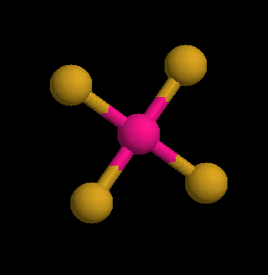
Octahedral Electronic Geometry: AB₆, AB₅U, and AB₄U₂
Molecular Geometry
Polarity

Slide 81
Compounds Containing
Double Bonds
Ethene or ethylene, C₂H₄, is the simplest organic compound containing a double bond.
Lewis dot formula
  N = 2(8) + 4(2) = 24
  A = 2(4) + 4(1) = 12
  S = 12
Compound must have a double bond to obey octet rule.

Slide 82
Compounds Containing
Double Bonds
Lewis Dot Formula

Slide 83
Compounds Containing
Double Bonds
VSEPR Theory suggests that the C atoms are at center of trigonal planes.

Slide 84
Compounds Containing
Double Bonds
VSEPR Theory suggests that the C atoms are at center of trigonal planes.
H
H
C
C
H
H

Slide 85
Compounds Containing
Double Bonds
Valence Bond Theory (Hybridization)
C atom has four electrons.
Three electrons from each C atom are in sp² hybrids.
One electron in each C atom remains in an unhybridized p orbital
2s 2p three sp² hybrids 2p
C ↑↓ ↑ ↑ ⇒ ↑ ↑ ↑ ↑

Slide 86
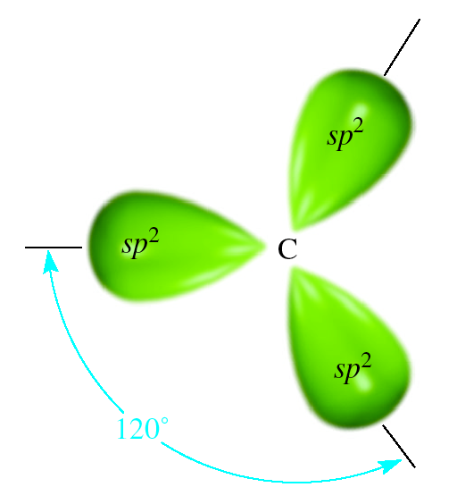
Compounds Containing
Double Bonds
An sp² hybridized C atom has this shape.
  Remember there will be one electron in each of the three lobes.
Top view of
an sp² hybrid

Slide 87
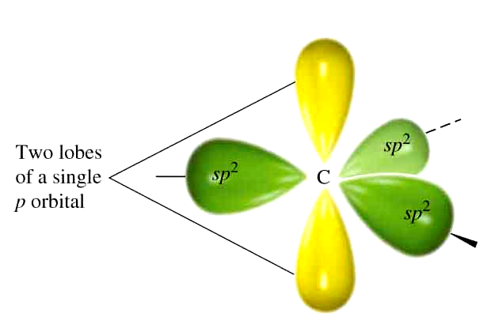
Compounds Containing
Double Bonds
The single 2p orbital is perpendicular to the trigonal planar sp² lobes.
  The fourth electron is in the p orbital.
Side view of sp² hybrid
with p orbital included.

Slide 88
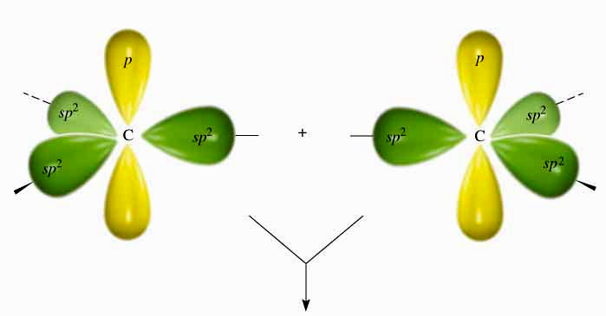
Compounds Containing
Double Bonds
Two sp² hybridized C atoms plus p orbitals in proper orientation to form C=C double bond.

Slide 89
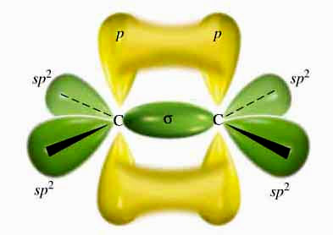
Compounds Containing
Double Bonds
The portion of the double bond formed from the head-on overlap of the sp² hybrids is designated as a σ bond.

Slide 90
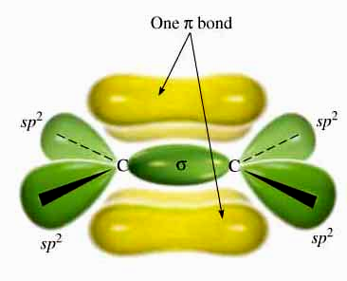
Compounds Containing
Double Bonds
The other portion of the double bond, resulting from the side-on overlap of the p orbitals, is designated as a π bond.

Slide 91
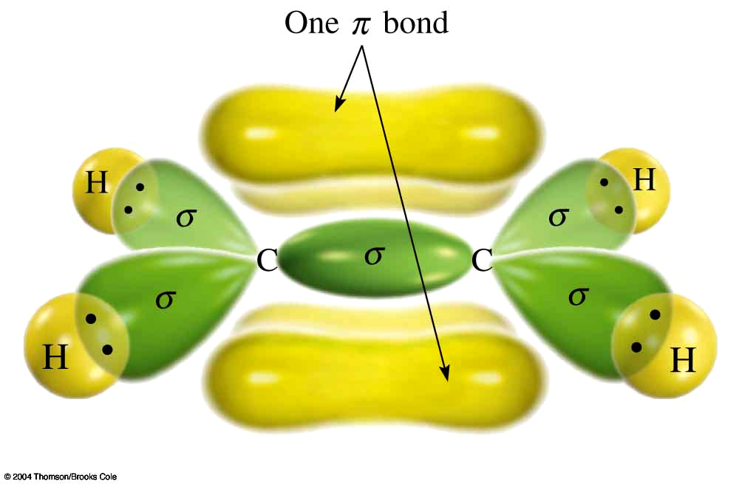
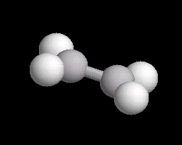
Compounds Containing
Double Bonds
Thus a C=C bond looks like this and is made of two parts, one σ and one π bond.

Slide 92
Compounds Containing
Triple Bonds
Ethyne or acetylene, C₂H₂, is the simplest triple bond containing organic compound.
Lewis Dot Formula
  N = 2(8) + 2(2) = 20
  A = 2(4) + 2(1) =10
  S = 10
Compound must have a triple bond to obey octet rule.

Slide 93
Compounds Containing
Triple Bonds
Lewis Dot Formula
VSEPR Theory suggests regions of high electron density are 180º apart.
H C C H

Slide 94
Compounds Containing
Triple Bonds
Valence Bond Theory (Hybridization)
Carbon has 4 electrons.
Two of the electrons are in sp hybrids.
Two electrons remain in unhybridized p orbitals.
2s 2p two sp hybrids 2p
C [He] ↑↓↑ ↑ ⇒ ↑ ↑ ↑ ↑

Slide 95
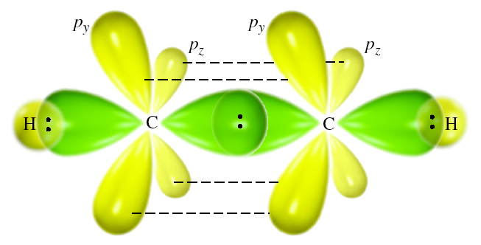
Compounds Containing
Triple Bonds
A σ bond results from the head-on overlap of two sp hybrid orbitals.

Slide 96
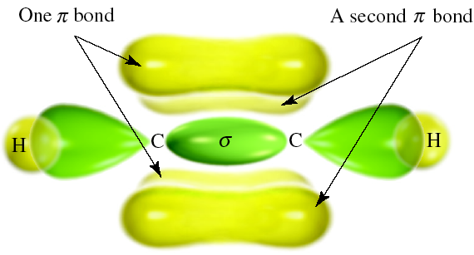
Compounds Containing
Triple Bonds
The unhybridized p orbitals form two π bonds.
Note that a triple bond consists of one σ and two π bonds.

Slide 97
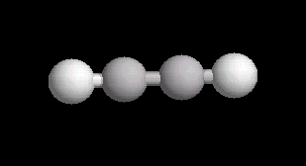
Compounds Containing
Triple Bonds
The final result is a bond that looks like this.

Slide 98










Summary of Electronic & Molecular Geometries

Slide 99
Synthesis Question
The basic shapes that we have discussed in Chapter 8 are present in essentially all molecules. Shown below is the chemical structure of vitamin B₆ phosphate. What is the shape and hybridization of each of the indicated atoms in vitamin B₆ phosphate?

Slide 100
Synthesis Question

Slide 101
Group Question
Shown below is the structure of penicillin-G. What is the shape and hybridization of each of the indicated atoms in penicillin-G?

Slide 102
End of Chapter 8
This is a difficult chapter.
Essential to your understanding of chemistry!

